Slide 1
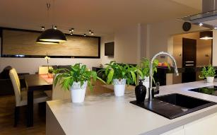
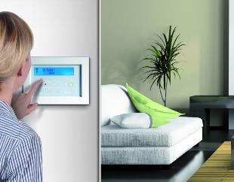
Connected Home
Protect. Live. Save
Smart Lifestyle at your fingertips.
Security and Beyond.
Notes:
Move to the next slide: Press the red circle with the arrow inside.

Slide 2
RISCO Connected Home Security with Style
Smart Lifestyle
Visual Control
Security & Safety
Smart Automation
Grudge
Control
Emotional
menu
Notes:
The flow of the slide:
Press the house icon – “Grudge” circle will appear to show the “core” of the RISCO offering – security and safety that people need to buy in order to comply with the insurance
Press the “Grudge” icon – the 2nd layer of RISCO offering will appear to designate the visual control that allows the home owner to be in control over the activity in the house, to see what’s happening when an alarm is triggered and to be able view what’s happening at home at any time
Press the “Control” icon – the 3rd layer of RISCO offering will appear – the emotional need to have a lifestyle system to reflect “coolness” in terms of being ahead of technology and keeping the environment green
Press the “Emotional” icon – the “Smart Automation” bar will appear to reflect that our system connects and integrates all 3 applications under one app with automation triggers between the systems (e.g. activation of video clip recording or smart automation scenario upon alarm event)
Press the “Menu” icon - to move to the next slide

Slide 3
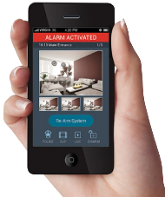
Connected Home Revolutionizing the way we live
Video
Power & lighting
Safety
Climate Control
Security
Smart Access
Intelligent Automation
Solution Architecture
Value Proposition
End
riscogroup.com
Notes:
This slide is the main menu of the presentation. It is possible to “jump” back from each slide to this slide.
Pressing each one of the icons leads to a slide that describes the subject of the icon.
The left side describes the existing system – security/safety and VUpoint.
The right side describes the home automation functions.
The suggested flow:
Show the various functions escribed above the house (from “Security” to “Smart Access”). You can select only the functions that are interesting to the specific customer. If it’s an existing RISCO customer for example , there will be no need to show the functions on the left
Show (Press) the “Solution Architecture” to explain how the systems are connected to the cloud
Show (Press) the “Intelligent Automation” to show how scenarios (presets) can be created
Show (Press) “Value Proposition” as the summary of the benefits to the installer and end user

Slide 4
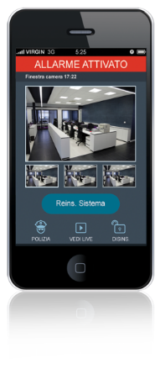
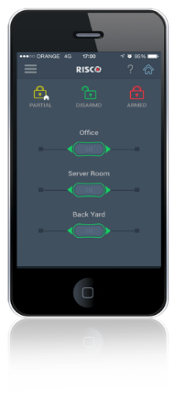
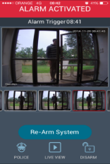
Interactive Professional Security You Know what’s Happening. You are in Control.
Push notifications
& live video
Remote arm & disarm
You Know
You Control
Whether your system is armed
Remote arm in case you forgot…
Remote disarm to let your relatives or a repairman in
When your kids arrive home from school
Bypass Detectors remotely to reduce false alarm hassle
When someone breaks into your house
View the scene during an event
Full Panel Range
What’s happening at home while away
All your sites at a go
Full Detector Range
Notes:
This slide presents the 2 major values provided to the customer by using the interactive iRISCO app:
The customer always knows what’s the status of the system and what’s happening at home
The customer is in full control of the system and the events wherever he is
Since this slide is about security, there is an option to present the panel range and the detector range by pressing the “Full Panel Range” and “Full Detector Range” icons (especially to new potential customers)
The (<) icon at the bottom leads back to the main menu.

Slide 5
Extensive Range of Security Panels
Electrical Wholesalers
Service Providers
Professional Installers
Integrators
CommPact
Wireless 1-way
iConnect
Wireless 2-way
WiComm
OEM Residential Gateway
Agility 3
Professional
Wireless 2-way
LightSYS 2
Professional
Hybrid
ProSYS Plus
Professional
G3 multi-zone
Residential
Commercial
Notes:
RISCO’s Panel Range.
The (<) icon at the bottom leads back to the “Interactive Professional Security” slide (slide number 4).

Slide 6
Diverse Range of Professional Detectors
Indoor
Safety
Detector Range
Outdoor
2-way Wireless
Perimeter
Visual Verification
Wireless DT
Hybrid
Notes:
RISCO’s residential Detector Range.
The (<) icon at the bottom leads back to the “Interactive Professional Security” slide (slide number 4).

Slide 7
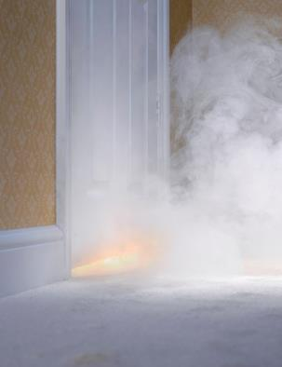
Home Safety You are on top. Always.
Flood
At Home: Save your Life
Away: Save Your Property
Fire
Gas
Notes:
RISCO’s safety offering.
Can be a good up-sell as a unique safety package to customers installing security systems.
Just by presenting the value of saving life and property.
The (<) icon at the bottom leads back to the main menu.

Slide 8
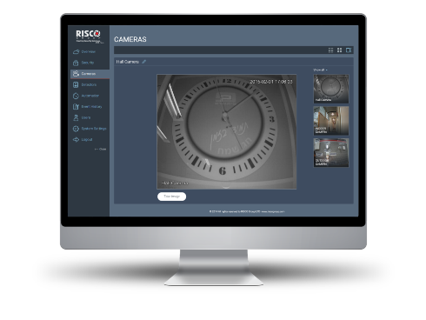
VUpoint Visual Monitoring Watch What you care about. Wherever. Whenever
Alarm Verification
Crystal clear HD Snapshots upon event
Smart 30sec high quality Clip capture for solid evidence
Never miss a moment with true Pre / Post Alarm
Live Event Viewing
Look In
See what’s happening in your property
Watch kids & Pets
Indoor & Outdoor
Identify your repairmen before disarming / opening
Cloud Archiving
Conclusive visual evidence in the cloud
Instant playback by associating images and clips to events
Clip & Image library
CMS Interface
Notes:
RISCO’s visual monitoring offering.
The 3 major values are presented:
Alarm verification – both for end users (control) and monitoring stations (saving money on false alarm call-outs)
Look in – enables the home owner to be in control of what’s happening at home anytime, anywhere
Cloud archiving – relevant especially for alarm verification for monitoring stations, but also for post-event analysis
The (<) icon at the bottom leads back to the main menu.

Slide 9
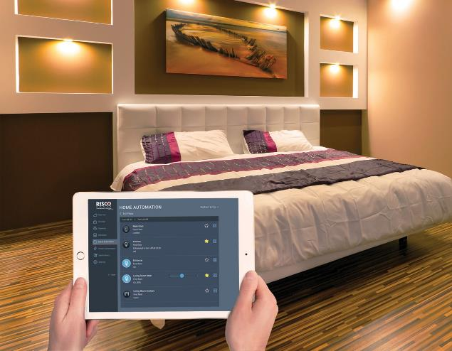
Power & Lighting
dimmer
Shutter
Smart Plug
Smart Lighting
Smart Roller Shutter
9
riscogroup.com
Notes:
Power & Lighting offering.
The (<) icon at the bottom leads back to the main menu.

Slide 10
Power & Lighting | Wall Plug Control. Educate. Save
On / Off and Dimmer Options
EU-E Plug
Applications:
Control
Set lamps, heaters and other appliances from your mobile
Lamps
EU-F Plug
Oil-Filled Radiators
Educate
Parental control: set schedules for your kids to watch TV / play games
water heaters
UK Plug
TV
TV Games (PlayStation, Wii)
Save
Switch off devices automatically when you leave home. Some devices consume a lot of power even when are not in “active mode” (computers, laptops, Audio devices, dispensers etc.)
EU-E / EU-F Plugs - On / Off Only
Notes:
Links to the manufacturers web sites:
Fibaro Smart Plug: http://www.fibaro.com/en/the-fibaro-system/wall-plug
TKB Smart Plug: http://www.tkbhome.com/?cn-p-d-277.html
The (<) icon at the bottom leads back to the “Power & Lighting” menu.

Slide 11
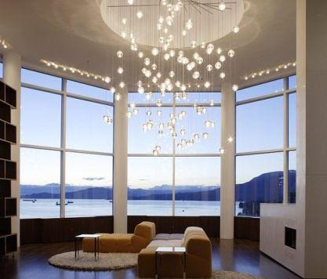
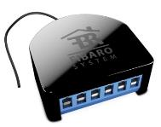
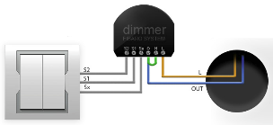
Power & Lighting | Lighting Switch Control. Protect. Save
Control
Your lights from your mobile
Protect
Automatic light settings make your home look occupied when you're out. (Lights send a clear “stay away” signal to intruders!)
Switch on all lights on intrusion event
Save
Keep the lights on only where and when you need them (smart schedules, leaving home, on the couch…)
Notes:
On / Off relays and dimmer relays, can be installed behind the switch (if there is enough room) or in a junction box.
Relay manual: http://manuals.fibaro.com/content/manuals/en/FGS-212/FGS-212-EN-A-v1.01.pdf
Dimmer Manual: http://manuals.fibaro.com/content/manuals/multilanguage/FGD-212/FGD-212-S-v1.02-USA.pdf
The (<) icon at the bottom leads back to the “Power & Lighting” menu.

Slide 12
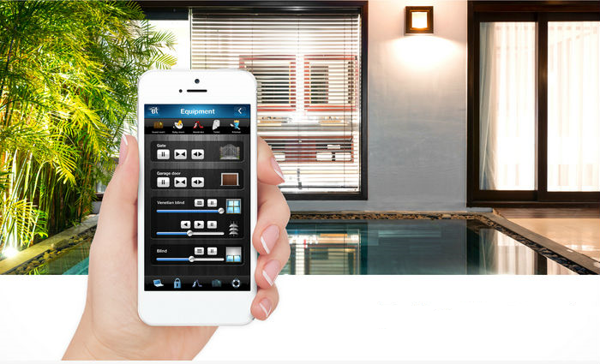
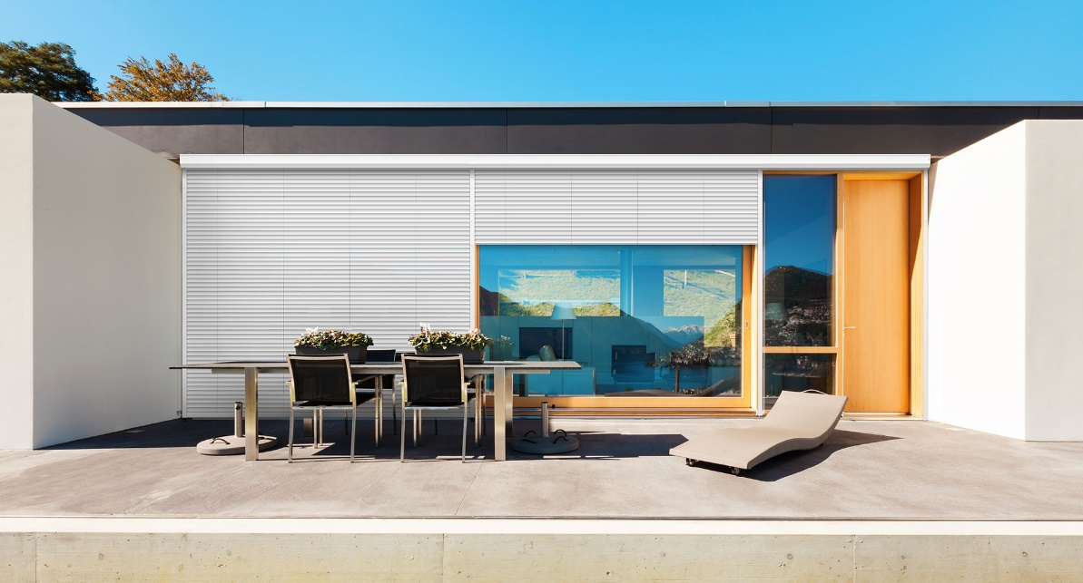
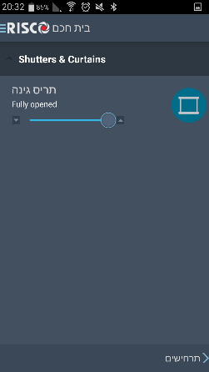
Power & Lighting | Smart Roller Shutter Style & Comfort
Comfort
Open & Close from the app
Scheduled Opening
Remote Opening / Closing
Smart Scenarios
Variety of Uses
Roller Shutters
Venetian Shutters
Electric Curtains
Notes:
Boiler timer – can be activated by the app to switch the boiler on/off or can be manually activated to 30/60/90 min by pressing the button at the bottom right corner.
Boiler time information:
The (<) icon at the bottom leads back to the “Power & Lighting” menu.

Slide 13
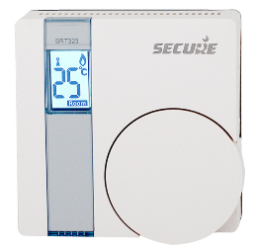
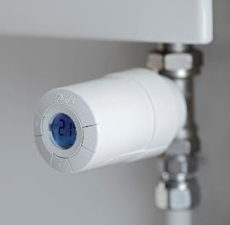
Smart Climate Control Use it only when you need it. Your Smart home will do it for you!
Stay Comfortable & Control your bills
Stay Comfortable
Program Your heating / cooling to start just before you:
1. wake up (scheduled)
2. Return home (scheduled / disarm)
Control Your Electricity/ Gas Bill
Program the system to stop heating cooling just after you:
1. go to sleep (specific areas can be switched off)
2. Leave home (arm away)
Set the temperature level in each room / area from your mobile. No need t get up from the armchair…
Keep the environment green!
Smart Room Thermostat
Smart Radiator Valve
Notes:
Thermostat (Climate Control) is the most important applications of Smart Home.
The idea is to control the temperature from whenever you are, save money on switching the heating off when it is not necessary (scheduling) and of course keep the environment green.
We have 3 types of thermostats:
Wall thermostat (battery operated) with built in-relay for local connection to the system:
Wall thermostat (battery operated) which can be located anywhere. The control of the heating system is done using a remote relay operated by Z-wave (associated to the thermostat rather than the gateway)
Radiator valve, which can control the temperature in a room where the radiator is. Using a low energy actuator it can control the flow of water in the radiator according to the desired temperature.
Battery life of the thermostats is between 1.5 – 2 years
The (<) icon at the bottom leads back to the main menu.

Slide 14
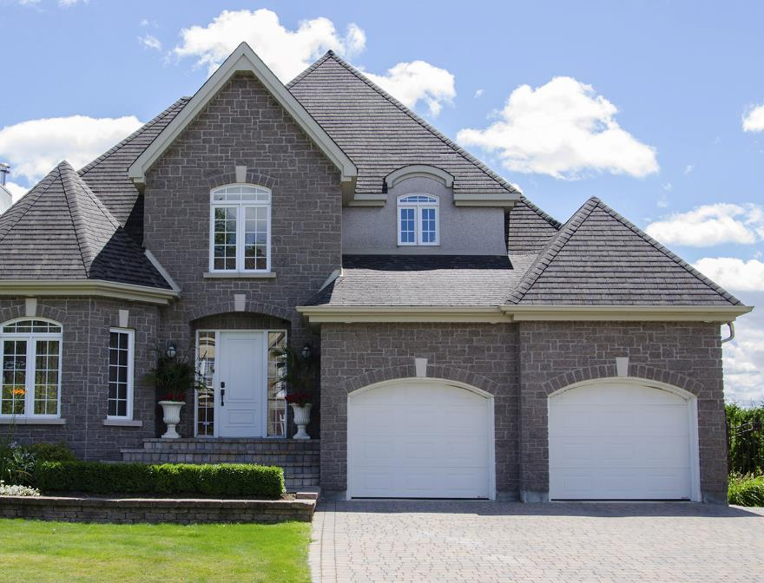
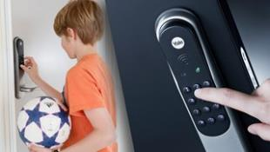
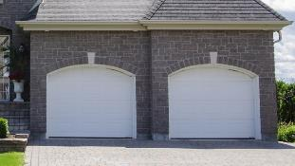
Smart Access
The kids don’t have to carry a key anymore Door opening by keypad or iRISCO app
No need to worry that you left the door open
Remote opening for your relatives or repairmen
No need to go downstairs for night time locking
Smart Door Lock
No need to carry a remote control any more
Pressing a single button while sitting in the car opens the garage door, locks the front door, arms the alarm and shuts down unnecessary power
No need to worry that you left the garage door open – the system will notify you
Smart
Garage Door
Notes:
Smart Access is a very important aspect of a Smart Home system which is combined with security.
The door lock we are offering is from Assa Abloy (different brands according to the country, like Yale, Multilock etc.)
All Assa Abloy locks have a standard Z-Wave interface, which will be integrated with the RISCO gateway in October 2016.
Example of locks:
UK
Door Lock: http://www.yale.co.uk/en/yale/couk/smart-living/keyfree-smart-lock/
Rim lock: http://www.yale.co.uk/en/yale/couk/smart-living/keyless-connected-smart-lock/
France
http://www.serrure-connectee-vachette.fr/fr/site/serrure-connectee/products/serrures-connectees/poignee-connectee-revomotion/
Other countries (including France, Italy, Benelux etc.):
http://www.mul-t-lock.com/en/site/mul-t-lock/for-home/entr/
Garage Door Locks
The following garage door controller will be implemented: http://aeotec.com/z-wave-garage-door-controller
It is not only a momentary rely, but also has a tilt sensor that tells you if the door is open or closed.
The (<) icon at the bottom leads back to the main menu.

Slide 15
RISCO Connected Home System Architecture
Home
User Interface
Service Provider
2G / 3G Backup
Security
End User
LAN / WiFi
Monitoring Station
Home Router
LAN / WiFi
RISCO Cloud
VUpoint
Value Added Service
LAN
IoT
Telecom / Utility
Smart Home
Smart Home Gateway
Installer Cloud
Notes:
This slide describes the system architecture of the RISCO “Connected Home” offering.
On the left side it shows the 3 elements that are connected on the home side: security, video and Smart Home.
This is one of the major advantages of RISCO – 3 solutions under one cloud / one app – professional security, High Definition video and Smart home. And it’s not only 3 separate solutions, but they are fully integrated in the cloud to provide triggers from one system to another.
Each on of the titles filled in RED, leads to an explanation page.
1. Pressing “Smart Home Gateway” leads to a page that provides a brief explanation on the installation process (slide 16)
2. Pressing “End User” leads to a page that describes the app / web interface and their benefits (slide 17)
3. Pressing “Installer Cloud” leads to a page that describes the values to the installer introduced by the Installer Cloud
The (<) icon at the bottom leads back to the system architecture slide (slide 15).

Slide 16
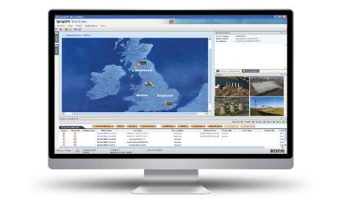
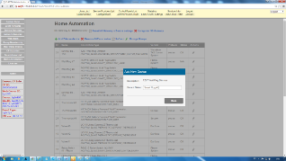
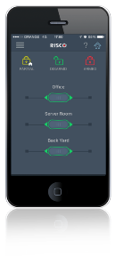
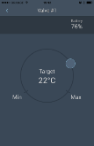
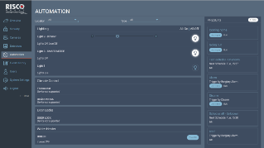
Smart Home Gateway Plug & Play. Local & Remote.
Network Cable
Plug & Play
Register Gateway
No configuration
ID: MAC Address
RISCO Cloud
Add Devices
Create Groups
Smart Home Gateway
Home Router
Define Presets
Direct over WiFi
Set Schedules
Activate Manually
Installer Cloud
User Interface
Notes:
This slide provides a brief explanation on how the entire smart home system works.
The animation is done by pressing the last item that has been presented
The flow is as follows:
Pressing the Smart Home Gateway icon shows that the connection to the home router is done using a cable (WiFi will be available in the future)
Pressing the Home Router icon shows that the connection to the cloud is Plug & Play without the need
Pressing the RISCO Cloud icon opens the Installer cloud interface and details the activities done by the installer (groups are locations that contains a group of devices. The group functionality makes it easier to navigate between the devices, for example if someone wants to activate something in the living room, he doesn’t have to search the device among all the devices every time, but only in the living room group)
Pressing the Installer Cloud Screen presents the user interface (app / web). The text near the arrow shows the activities that can be done from the app / web
Pressing the web UI screen shows that the internet link can go down
Pressing the smartphone shows that in such a case, the app can still operate the system locally over the WiFi (Both smartphone and gateway should be on the same WiFi network). Definition of presets and schedules will not be available, but manual activation and existing presets will be active.
The (<) icon at the bottom leads back to the main menu.

Slide 17
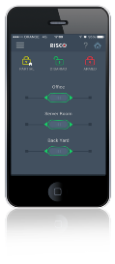
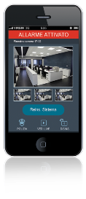
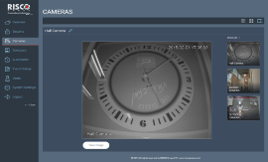
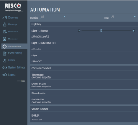
iRISCO One App. Multiple Services.
Video
Security
Smart Home
Plug & Play
Push Notifications
Stylish & Intuitive UI
Branded App
Multi-Site
Notes:
This slide shows the RISCO Cloud user interface (iRISCO web and app)
It also explains the values and the advantages over competition:
Plug & Play – no need for a static IP address or port configuration. Other systems without a cloud require complex configuration
Push notifications – only cloud-based systems allow it
Branded app – FreeControl – unique to RISCO
Multi-Site – up to 15 sites receiving push notification on the same app – unique to RISCO
The (<) icon at the bottom leads back to the system architecture slide (slide 15).

Slide 18
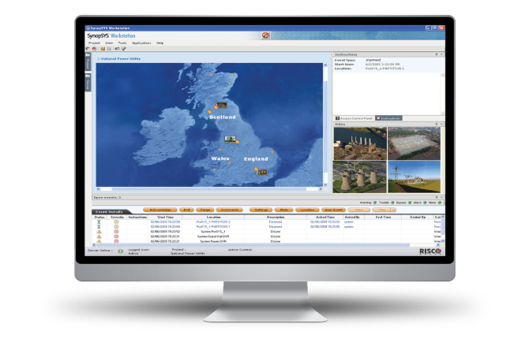
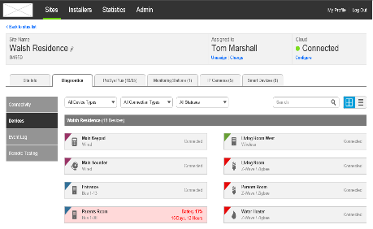
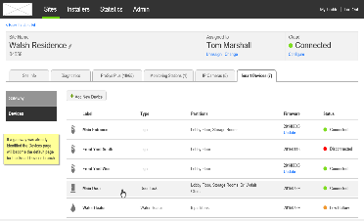
Installer Cloud Manage. Grow. Sustain
Manage Your Installations
Professional GUI
Monitor Devices Remotely*
RRI
Protect your Revenue
Control App
Manage Profiles
Billing Interface*
Grow your Business
Competitive Advantage
Unique up-sale opportunities
Profile Mngt. – Package Offering
riscogroup.com
Notes:
This slide describes the RISCO Installer Cloud value proposition.
The idea is that the RISCO installer cloud helps the installer to:
Manage the installations – currently mainly monitoring the status of the system and enabling/disabling a system. In the near future the system will enable monitoring of devices, CS from the cloud and many more dashboards enabling the installer to make hi installations and maintenance more efficient
Protect the revenue – currently the installer can connect /disconnect the system / app in case the customer did not pay for the system or the monthly fee. The profile management feature is very useful, as the installer can reduce the level of functionality of the app to non-paying users. In the near future we will introduce a billing system that will help the installers to bill their customers more efficiently.
Grow the business – the fact that the cloud will soon allow system monitoring up to the detector / device level, allows offering of packages using the profile management feature
The (<) icon at the bottom leads back to the system architecture slide (slide 15).

Slide 19
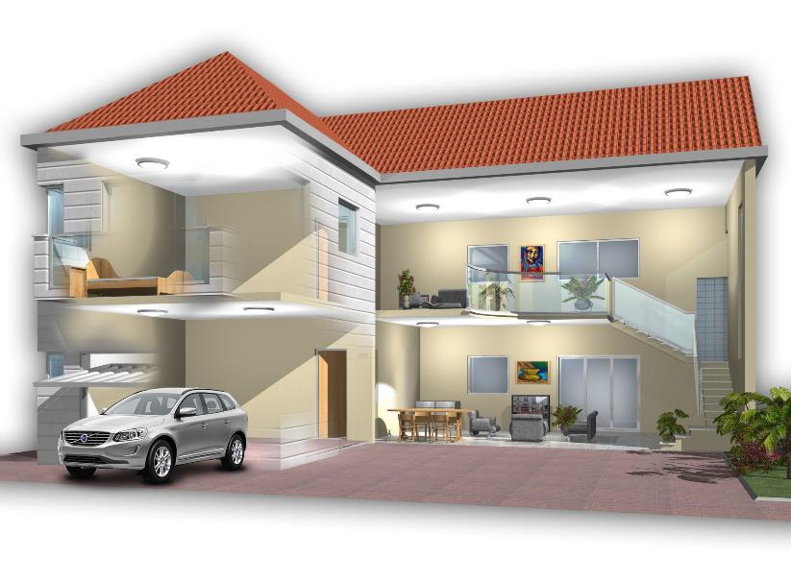
Lights
On
Garage Door
Locked
water heater
On
Smart Automation Presets & Scenarios. Let the system work for you & your lifestyle
Front Door
Locked
Coffee machine On
Heating
On
Interior alarm Off
Perimeter alarm
Off
Smart Schedules
Triggered Scenarios
Manual Activation
Notes:
This slide is the entry opening slides of the “Smart Automation” section.
Smart Automation is done by defining Presets (scenarios) which are actually a set of actions on smart home devices.
This slide describes a common state when people are at home: the lights are on, the heating is on, water heater is on, alarm is disarmed etc.
The automation can be triggered by either of the following in 3 ways:
1. Smart Schedules – a Preset is activated on a specific time on selected days of the week
2. Triggered Scenarios – a Preset is triggered by one of 3 possible alarm events – System Arm / System Disarm / Alarm
3. Manual activation – a Preset is activated manually by selecting it on the Presets screen on the web / app
By Pressing each one of the grey buttons at the bottom (Smart Schedules/Triggered Scenarios/Manual Activation), a relevant example of the specific automation type is displayed on the screen. You can toggle between the examples.
The (<) icon at the bottom leads back to the main menu.

Slide 20
Lights
Off
Garage Door
Locked
water heater
On
Smart Schedules Pre-Defined Daily or weekly events according to your habits
Front Door
Locked
Coffee machine On
Heating
On
Interior alarm Off
Perimeter alarm
Arm
Wakeup
Smart Schedules
Triggered Scenarios
Manual Activation
Notes:
“Smart Schedules” slide:
This slide shows an example of a smart schedule.
The scenario name is “wakeup”. See bottom left.
The idea is to show that we can create a smart schedule that will prepare the home for wakeup: start heating in the living room, start the water heater (for taking a shower the moment we wake up) and connect the coffee machine to start heating.
It can be scheduled for example to 6:00am so that when the children wake up at 6:30-7:00am, the living room is warm and there is hot water for the shower.
The (<) icon at the bottom leads back to the main menu.

Slide 21
Lights
Off
Garage Door
Locked
water heater
Off
Event-Triggered Activation Set Actions as a response to a security event
Front Door
Locked
Coffee machine Off
Heating
Off
Interior alarm
Arm
Perimeter alarm
Arm
System Arm
Smart Schedules
Triggered Scenarios
Manual Activation
Notes:
“Triggered Scenarios” slide:
This slide shows an example of a scenario triggered by an alarm event.
The scenario name is “system arm”. See bottom left.
The idea is to show that we can create a preset that will shut down all unnecessary power consumers and make sure the door is locked.
By activating “arm” state in the app, the lights will be shut off, the heating will be off (low temp), the water heater and other appliances connected to the smart home system will be off and the door will be locked.
The (<) icon at the bottom leads back to the main menu.

Slide 22
Lights
Off
Garage Door
Locked
water heater
Off
Manual Activation Pre-defined group of actions manually activated when you decide
Front Door
Locked
Coffee machine Off
Heating
Off
Interior alarm
Off
Perimeter alarm
Arm
Going to Sleep
Smart Schedules
Triggered Scenarios
Manual Activation
Notes:
“Manual Activation” slide:
This slide shows an example of manual activation.
The scenario name is “going to sleep”. See bottom left.
“Going to sleep” is a manually activated preset because it can’t be scheduled, as we don’t go to sleep every day exactly at the same time…
The idea is to show that we can make our life very comfortable by lying in bed, pressing a button and the lights in the bedroom will shut down, the lights anywhere else in the house will be off as well, the door will be locked (how many times you got from bed just to check if the door is locked?), the thermostat in the living room will be off etc. This way I am not only making my life comfortable, but also I save power by making sure all unnecessary power consumers are off, without counting on my memory.
The (<) icon at the bottom leads back to the main menu.

Slide 23
End User
Installer & CMS
Value Proposition
Notes:
Value proposition Title Page
In this page you can select if you wish to present the value for the end user or the installer.
Pressing “End User” icon will lead to slide 24 – End user Value Proposition
Pressing “Installer & CMS” icon will lead to slide 25 – “Installer & CMS” Value Proposition
The (<) icon at the bottom leads back to the main menu.

Slide 24
The Value proposition End User
Smart Energy Management
Control, save and enjoy well being
Visual Control
You know what’s happening
End User
Professional Security - no compromise
Smart Lifestyle
Someone manages your house according to your habits
Peace of Mind
It doesn’t concern you if you forgot…
One System. One Interface. Protect, Live, Save.
Notes:
“End User Value proposition” slide
Professional Security – as RISCO is first and foremost a provider of professional security systems, the end user is not compromising his security, which is the case for unprofessional DIY systems with Z-Wave or other “toy” detectors with unknown detection / false alarm rates
Visual Control – the high quality, high definition VUpoint camera enables home owners to know what’s happening at home at any time, upon alarm event, or in the afternoon if they want to see what their kids are doing
Smart Lifestyle – you program your habits into the app and the system is managing your home according to your needs
Energy Management – when you are not at home, you can now switch off appliances that consume energy in standby mode, make sure the thermostat is activating the heating system only when you are at home and need it etc. thus saving hundreds of Euros/dollars every year
Peace of Mind – you are now in full control of what’s happening at your home, you are in control of your electricity bill and you never need to worry anymore if you locked the door, switched off the lights somewhere, the heating etc.
The bottom line – you get a holistic solution from RISCO, where you can protect your home, enhance your lifestyle and save money from one smartphone app interface.
The (<) icon at the bottom leads back to the value proposition menu page (slide 23).

Slide 25
The Value proposition Installer & CMS
Unique comprehensive offering – competitive advantage, Growth Engine
New Addressable market
Standalone smart home / video
Brand Your Business
With RISCO FreeControl and branding Awards
Installer & CMS
Attractive Up-Sale
Seamless integration with existing cloud installations
The cheese is moving
Compete with mass market telecom / utilities offering
Revenue Generating Value Added Solutions
Notes:
“Installer & CMS Value proposition” slide
Unique Comprehensive Offering – RISCO is providing its customer with a unique offering of professional security combined with video and smart home. Such comprehensive package is something very few (if at all) of our security competitors offer. It created great, unique up-sale opportunities for installers and monitoring stations and positions them in a good place compared to competition
Attractive Up-Sale – The VUpoint and Smart home makes the total value of the sale much bigger – in many cases double of triple. It also creates an opportunity to up-sale in existing installations that are connected to the cloud.
New Addressable market– until now, the security installation were mainly targeted at houses that required an alarm system for insurance purposes. Now new opportunities are being opened with apartment owners – providing them with added values of video and lifestyle. Significant opportunities are now coming up with builders and developers of apartment buildings, who can significantly increase the perceived value of their property by a small investment in a basic smart home solution
The cheese is moving – when you are not at home, you can now switch off appliances that consume energy in standby mode, make sure the thermostat is activating the heating system only when you are at home and need it etc. thus saving hundreds of Euros/dollars every year
Peace of Mind – you are now in full control of what’s happening at your home, you are in control of your electricity bill and you never need to worry anymore if you locked the door, switched off the lights somewhere, the heating etc.
The bottom line – you get a holistic solution from RISCO, where you can protect your home, enhance your lifestyle and save money from one smartphone app interface.
The (<) icon at the bottom leads back to the value proposition menu page (slide 23).

Slide 26
Thank You
26
riscogroup.com

